Slide 1
Final Project
Albert Millan - 2019280366
Bastien Bedu - 2019280421

Slide 2
Contents
Problem Definition
Approach
Architecture
Querying
Monitoring
Advanced Features
Future Work
Notes:
Explan Hadoop failure.
Talk 3 minutes during architecture

Slide 3
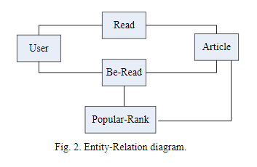
Problem Definition
• Derive a partitioning and replication strategy based on the user access patterns, nature of the data, and location.
• Identify a DDMS that fulfills the requirements.
• Automated DDMS server status monitoring.
• Add Be-Read Table & People Rank
Notes:
We need to derive a partitioning and replication strategy based on the user access patterns, nature of the data, and location (Beijing/Hongkong).
• Identify a distributed database management system that fulfills the requirements (autonomously fragmenting the data based on the amount and the location, the workload: enabling for insert, updating and read queries in an efficient manner).
• Automated DDMS server status monitoring
• Speak about the schema

Slide 4
Approach
Don’t reinvent the wheel!
MongoDB:
Sharding
Replication
Monitoring
Notes:
Query processing to us.

Slide 5
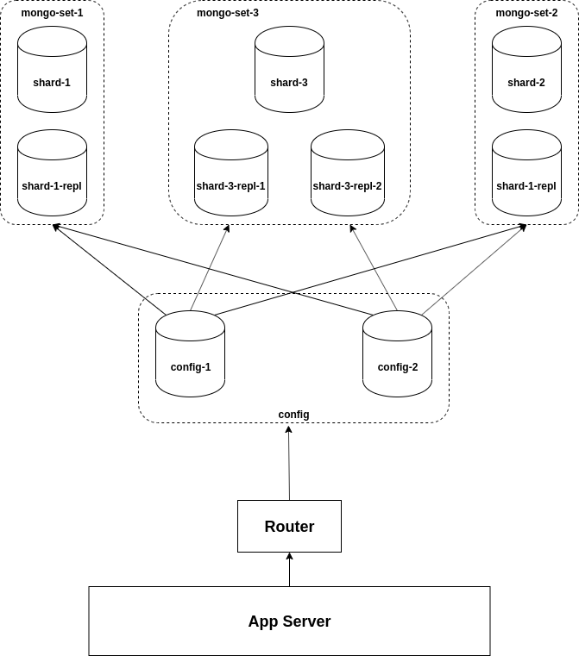
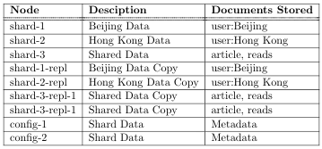
Architecture
Sharding Strategy
Replication Strategy
Advantages
Limitations
Scripting
Notes:
Limitations:
One router only
Images stored in App server file system.

Slide 6
Querying
Map Reduce
Be-Read Table & People Rank

Slide 7
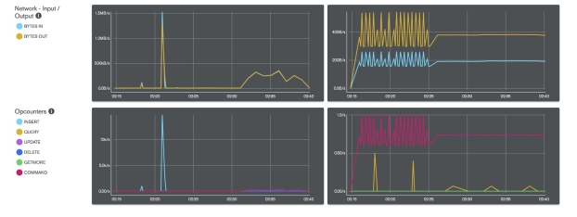
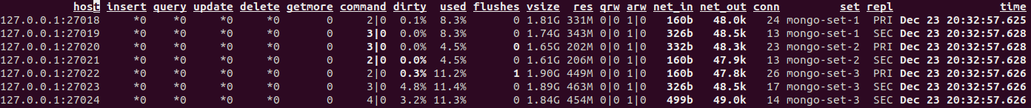
Monitoring
Free Monitoring
Version 4.0
Mongostat
Real-Time
JSON

Slide 8
Advanced Features
Dropping a server node at will.
Failure responsive.
Adding & Sync additional node servers.
Notes:
We have a process running every 2.5 seconds. Every time it runs, it gets the current state of each node in the cluster as JSON file. If
moveChunk operation

Slide 9
Future Work
Router Replicas
Containerized/Hadoop File System
Authentication
UI

